Slide 1
FACADE PATTERN
A patterns-box talk
by
Claudia Montalvo
“The face of the building”
Notes:
Hi guys, thank you all for attending. This presentation is to talk about facade design pattern as part of patterns-box talk.

Slide 2
About me
Hi, This is Claudia, Senior Developer at Belatrix. Currently working at Delta Team on Enterprise APIs.
Notes:
I’m Claudia, Senior Developer at Belatrix. Currently working at Delta Team on Enterprise APIs.

Slide 3
01
02
03
04
05
What is a pattern?
Goal
Architecture
Real world case
Problems it solves
Notes:
This is the agenda we are going to follow

Slide 4
06
07
08
09
10
When to use it?
Effects
Common mistakes
Demo
Summary

Slide 5

What is a Pattern?
General repeatable solution to a commonly occurring problem in software design.
Notes:
So, let’s start defining what is a pattern. A design pattern is a general repeatable solution to a commonly occurring problem in software design.
In other words it’s a description or template for how to solve a problem that can be used in many different situations.

Slide 6

Goal
Simplify how to consume a complex existing system.
Notes:
Facade pattern is often needed when there is a large number of interdependent subsystems being consumed by some clients. So, the main goal of this pattern is simplify how to use an existing system hiding all the complex details. ‌Two keywords to help us understand this pattern are:
Simplication which is the goal of this design pattern: simplify a complicated system.
Restriction Simplification often comes with a “cost”, restriction. By simplifying the code, we restrict/hide clients from fully functionality in comparison to working with the subsystem directly. However, it includes only those features that clients really care about.

Slide 7

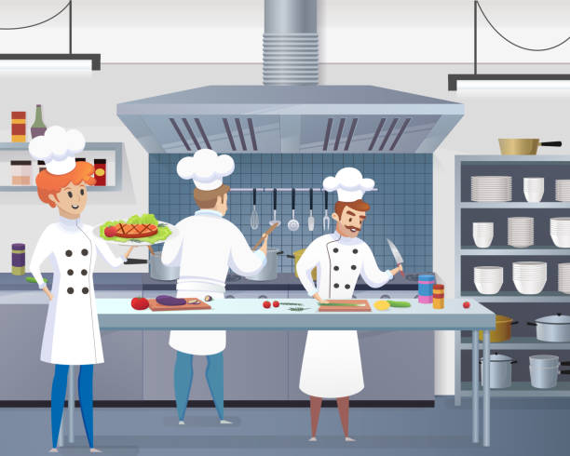
Architecture
Clients
Kitchen
Notes:
Let’s see a common situation where facade pattern is being applied. On the above picture we have some customers on a restaurant.
Customers orders food from the menu
The order goes to the kitchen
And the food comes back after a while
Customers doesn’t need to know:
who will cut the meat
how long will it be cooked
who is going to wash the dishes
So,the menu serves here as a facade that makes easier for the customer to get the food and avoiding the complexities coming from the kitchen.

Slide 8

Architecture
Other Subsystem
Waiter
Order Facade
Kitchen
Other Subsystem
Other Subsystem
Customers
Notes:
So, translating our example to an architecture diagram we have that:
Our customers are the clients who need to consume the subsystems.
The menu is the facade that hides all the complexity of the subsystems...making them easier to be consumed by the clients
All the roles in the kitchen are the subsystems that are hidden from the client

Slide 9







Real world case
Clients
Subsystems
Facade
Notes:
Let’s think on another case where this pattern is applied. We have a lot of applications we frequently use as
Calendar,
Spotify
And Netflix.
On the other hand we have the Google assistant app. This app let us interact with all the other apps in a simplify way by creating routines. When we setup a routine on google home assistant it can involve:
turn on the lights,
play some spotify playlist,
read the news,
and so on
without having to open each application. All that complexity is hidden from us by using the google assistant app. Therefore, Google assistant makes easier for the clients (as google home speaker or mobile phone) to interact with our applications.

Slide 10

Problems it solves
Reduces the learning curve of the subsystem.
Makes a subsystem easier to use by wrapping it.
Decouple subsystems from its clients
Limit/restrict features and flexibility that users may need.
Notes:
Let’s see what problems this pattern is solving
Clients don't need to fully understand what the subsystem is doing. So, we are taking down the learning curve.
We provide a much more easier and friendlier way to consume the subsystems by hiding the complexity inside the facade.
Clients are no longer tightly coupled to subsystems.
We are able to limit the features that users may need Imagine you need to integrate your app with a complex and sophisticated library which has tons of features, but you just need a tiny bit of its functionality. Facade will restrict/limit the functionality by including only those features that clients really care about.

Slide 11

When to use it
Need to expose a complex system in a simplified way to consume and use
A system is too complex and difficult to understand
Wrap a poorly designed API in a better designed one
Notes:
Now let’s talk about when to use it
Facade is handy when you have a complex system that you want to expose to clients in a simplified way
The aim of this pattern is simplify a complicated system displaying a friendly face by hiding all the complexities.
It allows to hide poorly designed APIs or legacy code behind well designed facades

Slide 12
When to use it
Expose a set of complex interactions with a single interface
Integrate your app with sophisticated libraries with tons of functionality
When you are planning to change the subsystem in the future
Notes:
When you need to expose a set of complex interaction between the subsystems through a single interface that appears simple on the outside.
Sophisticated libraries handles tons of complex functionality. If you only need a few set of its functionalities then Facade will became really handy because it allows you to expose only those features that your application needs
If you would like to be able to change implementation of subsystem in the future, while still providing consistent functionality through a stable interface

Slide 13

Effects
Existing subsystem is simplified
Create new/ Update Facade to expose more functionality
Full capability of subsystems will not be available from Facade
Notes:
Complexity is hidden to provide a much more easier and friendlier way to be consume it.
Facade expose a limited set of subsystems functionalities. So if we need to expose more subsystems features we will need to either update the existing facade or create a new one.
Facade will limit the features and flexibility that subsystems can offer.

Slide 14

Common Mistakes
Creating unnecessary facades.
Forcing client classes to interact with subsystem through the facade.
Create facade layer for simple calls.
Creating facade layer in advance.
Notes:
When we apply this pattern just for the sake of create a facade layer instead of assess deeply whether applying it is adding real value to our design. Keeping in mind YAGNI and KISS principles will help us.
Facade layer should not be forced and it's always optional. If the client wishes to interact with components directly it should be allowed to bypass the facade layer.
Imagine facade with methods that has only one or two lines which calls the other subsystems. If facade is going to be so simple it invalidates its purpose (It’s supposed to encapsulate complexity) and would be better to let clients call directly the subsystems and avoid an unnecessary layer.
Don't create facades in advance just because you feel the subsystem might evolve and become complicated. You might end up introducing an abstraction layer you may not use. YAGNI principle will help you to avoid adding unnecessary complexity.

Slide 15
Common Mistakes
Reference for facade in subsystems.
Adapter and Facade are both wrappers but they are differents.
A facade can become a god object coupled to all classes of an app.
Notes:
Subsystems are not aware of facade. So there should be no reference for facade in subsystems.
The intent of Facade is to produce a simpler interface while the intent of Adapter is make two existing interfaces work together.
If we not pay enough attention facade can easily become a god object coupled to all classes of an app.

Slide 16

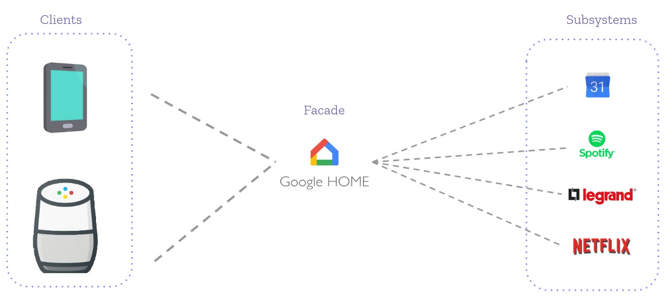
Live code
Notes:
Let’s take a look at a sample code

Slide 17
Summary
Facade provides a single interface
Developers comfort is a main purpose of facade
Simplicity is the aim of facade
Facade promotes subsystem independence and portability
Subsystem may be dependent with another one.

Slide 18



